Slide 1
Retail Product Management
Final Project
Cohort ADM22DF042
Team-1

Slide 2
Team Members
Manish Shingare (TL) - 2125636
Dhriti Sinha - 2125946
Prajwal Nirmal - 2125331
Ashi Agrawal - 2125257
Priyanka Jatav – 2125801
Himanshu Singh - 2125459

Slide 3
About the Project
A leading Retail Organization wants to strengthen its Middleware by exposing the core logic related to Product Management as Microservices.
There is also an e-Commerce Portal that is developed as part of this scope, that consumes these Microservices and responds back to customers who are purchasing a product.

Slide 4
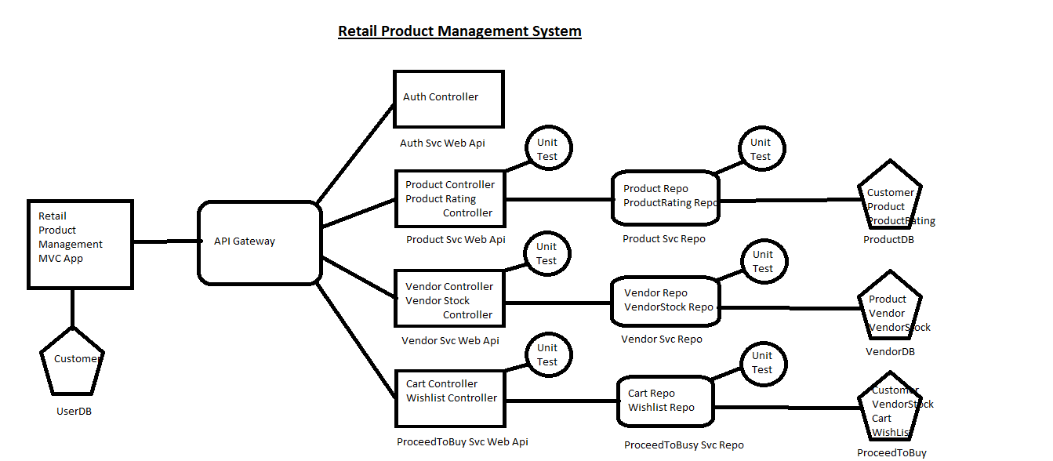
Project Structure

Slide 5
Project Modules
Product Module
Vendor Module
Proceed to Buy Module
E-commerce Portal

Slide 6
Product Microservice
Product microservice contains following endpoints:
Add new Product
Return all Products
Search Product by Id
Search Product by Name
Add Rating to Product
Return all Product Ratings
Search Product Ratings by Customer Id
Search Product Ratings by Product Id

Slide 7
Vendor Microservice
Vendor microservice contains following endpoints:
Add a new Vendor
Return all Vendors
Search Vendor by Id
Add a new Vendor Stock
Return all Vendor Stocks
Search Vendor Stocks by Product Id
Search Vendor Stocks by Vendor Id
Search Vendors by Product Id

Slide 8
Proceed to Buy Microservice
ProceedToBuy microservice contains following endpoints:
Add Product to Cart/Wishlist
Return all Carts/Wishlists
Search in Cart/Wishlist by Product Id
Search in Cart/Wishlist by Customer Id
Search in Cart/Wishlist by both Ids

Slide 9
Authentication Service
The authentication service provides a single endpoint which returns a JSON Web Token (JWT) when the secret key is passed to it.
The JWT also contains 2 claims:
UserId, and
Role
The role is used for authenticating the controllers in other microservices.

Slide 10
API Gateway
An API gateway is an API management tool that sits between a client and a collection of backend services.
An API gateway acts as a reverse proxy to accept all application programming interface (API) calls, aggregate the various services required to fulfill them, and return the appropriate result.

Slide 11
E-Commerce Portal
The E-Commerce Portal is an ASP.NET Core MVC App.
It has the following controllers:
Home
Users
Products
Product Ratings
Vendors
VendorStocks
Carts
Wishlists

Slide 12
Thank You.

